Slide 1

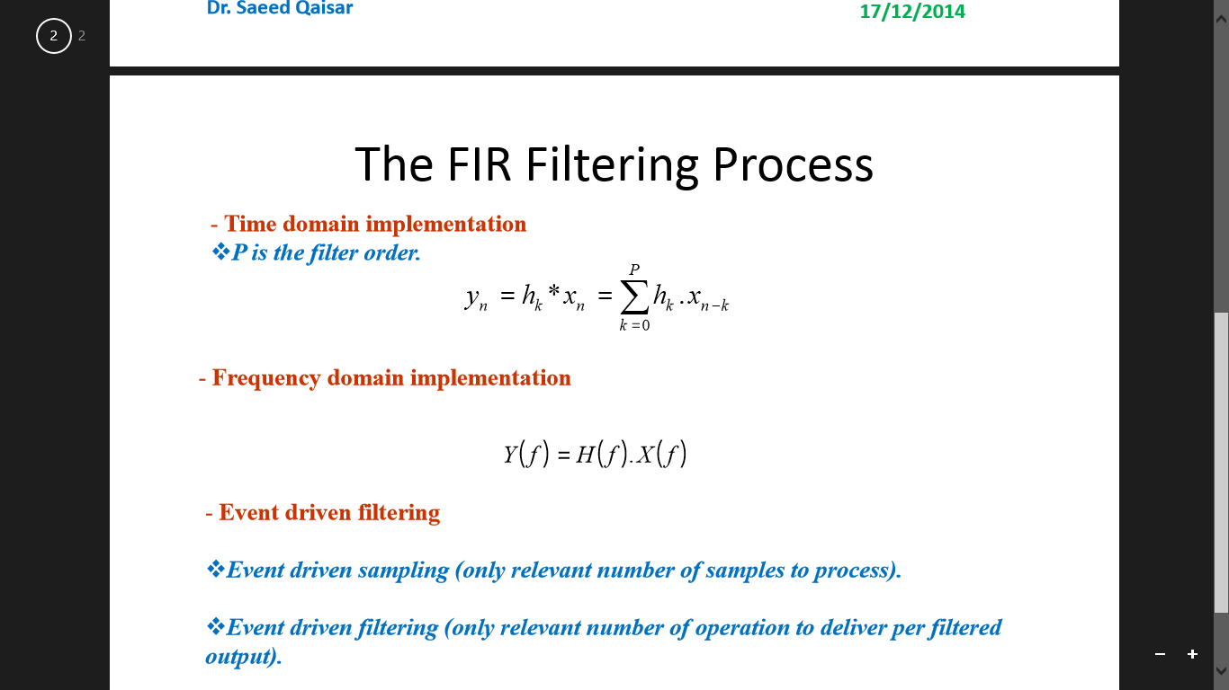
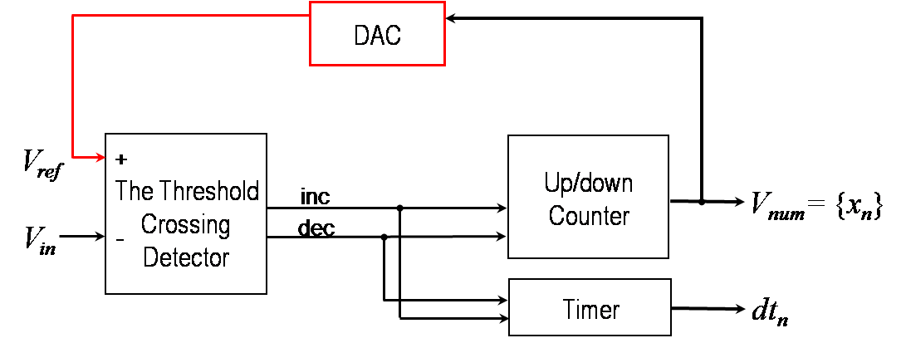
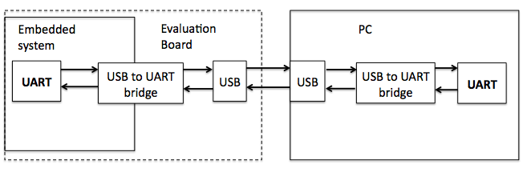
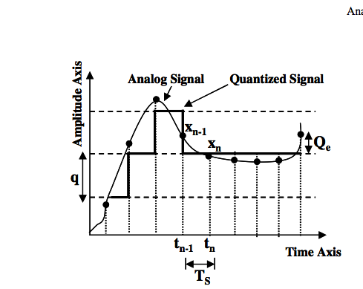
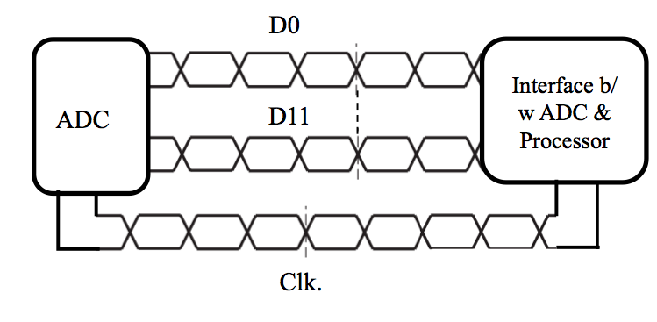
Efficient Filtering Technique Based on Adaptive Rate Sampling
Haneen Mohammed†, Israa Alqassas†, Reemaz Hetaimish†, Sarah Alharthy†
Supervisor Dr. Saeed Qaisar, Email: sqaisar@effatuniversity.edu.sa
† Effat University
MOTIVATION
To contribute in the development of low computational complexity and power efficient signal processing chain for mobile systems.
It will lead towards ever wanted system features like reduced size, cost, processing noise, electromagnetic emission and especially power consumption.
Solution
Reorganize the mobile systems associated signal processing theory and architecture
3. Circular Buffer
The circular buffer is employed to store the sampled signal temporarily before being processed.
4. Digital Signal Processing
Computational Complexity
Classical Case: N.P+1 Multiplications and N.P Additions
ED Filtering case: M.P+1 Multiplications and M.P Additions, Here M <N.
II. EDADC Architecture
5. Dual-Port RAM
The values of the processed signal are then saved in a dual port RAM (Random Access Memory) ready to be transferred to a PC .
6. Processor to PC Interface
S. QAISAR 2009
Non Uniform Sampling Principle
x_{n-1}
x_{n}
X(t)
x_{n}
X(t)
Amplitude
Amplitude
t_{n-1}
t_{n}
Time
T_{s}
Time
dt_{n}
Event DrivenSampling
ClassicalSampling
The proposed System Principle BLOCK DIAGRAM
ALLIER 2006
Analog Signal
ADC
Interface b/w ADC & Processor
Circular Data buffer
Digital Processing
Memory
Interface b/w Processor & PC
Interface b/w Processor & PC
Memory file
PC
Data Analyzer
System design
1. ADC
The conversion process starts by sampling the input analog signal and then rounding off these samples amplitudes that will produce the digital signal.
2. ADC to Processor Interface
The following are the characteristics of the ADC to Processor Interface:
Differential Ended
Double Data Rate
Sinc Synchronous
Conclusion
A novel computationally efficient filtering technique has been devised.
It takes advantages of both non-uniform and uniform signal processing tools
prospects
The proposed filtering technique is a potential candidate for applications, deal with low activity sporadic signals. Certain examples are speech, audio, image, Electrocardiogram and Electroencephalogram.
Other interesting domains are PET scanners and Battery Management Systems.
clk
References:
• S.M. Qaisar et al., “Adaptive Rate Filtering a Computationally Efficient Signal Processing Approach”, ELSEVIER Signal Processing Journal, 2014. • S.M. Qaisar et al., “Computationally Efficient Adaptive Resolution Short-Time Fourier Transform”, EURASIP, Research Letters in Signal Processing, 2008.
• S.M. Qaisar, “An Efficient Signal Acquisition with an Adaptive Rate A/D Conversion”, IEEE, ICCAS’13, Kuala Lumpur, Malaysia, 2013.
• Kirill Kozmin et al, “Level-Crossing ADC Performance Evaluation Toward Ultrasound Application”, IEEE Transactions on Circuits and Systems, 2009.
Acknowledgements: we acknowledge Dr. Saeed Qaisar for his continuous support
throughout the course of our work. [SQAISAR@EFFATUNIVERSITY.EDU.SA]

